Slide 1
SONAR

Slide 2
SonarQube
SonarQube is an open source tool suite to measure and analyse to quality of source code.
It is written in Java but is able to analyse code in about 20 different programming languages.
Code analysis may be started manually by executing a so-called sonar runner
but SonarQube’s full is potential is especially revealed when used in combination with continuous integration such as a Jenkins server.
The results of an analysis are shown in a fancy web frontend with ‘green’ and ‘red lights’, nice charts, issue lists and an ability to drill down from project level to a single class.

Slide 3
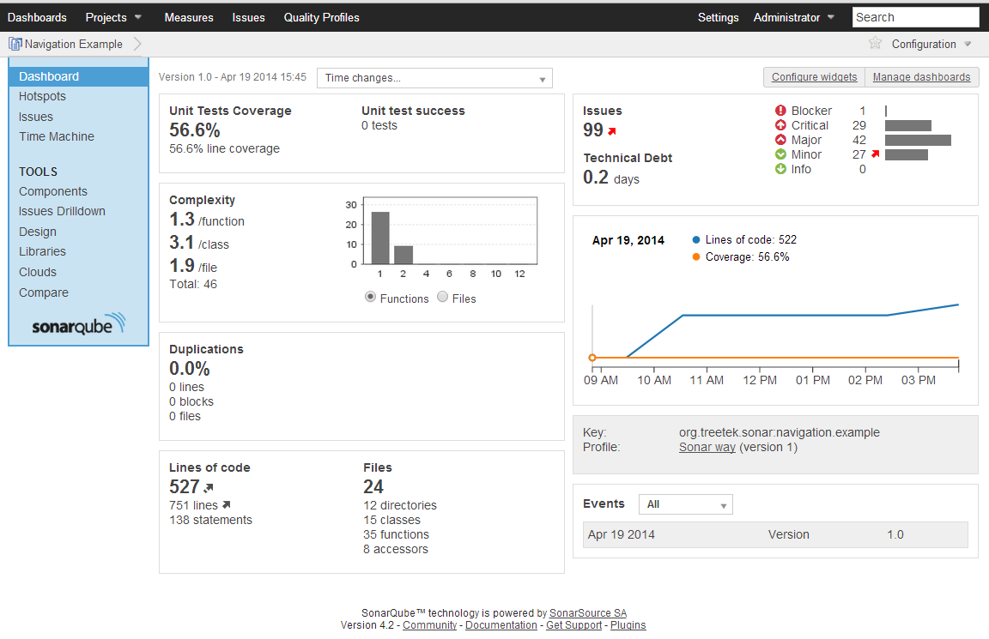

Slide 4
Install on windows
1) Download Sonarqube 5.6.7 zip file and Extract into C:\Program Files
https://binaries.sonarsource.com/Distribution/sonarqube/sonarqube-5.6.7.zip
2) set the classpath SONAR_HOME
3) cd C:\ Program Files\sonarqube-5.6.7\bin\windows-x86-64
installMTservice.bat
startMTservice.bat
4) http://localhost:9000
Login usr: admin pwd: admin

Slide 5
Integration of sonar two ways
Raw way with maven
With jenkins

Slide 6
Sonar with maven
<settings>
<profiles>
<profile>
<id>sonar</id>
<actitivation>
<actitivationByDfault>true</actitivationByDfault>
</actitivation>
<properties>
<!-- SERVER ON A REMOTE HOST -->
<sonar.host.url>http://localhost:9000</sonar.host.url>
<sonar.login>admin</sonar.login>
<sonar.password>admin</sonar.password>
</properties>
</profile>
</profiles>
</settings>

Slide 7
run sonar from maven
mvn compile
mvn package
mvn sonar:sonar

Slide 8
Sonar Integrate with jenkins
http://repo1.maven.org/maven2/org/codehaus/sonar/runner/sonar-runner-dist/2.4/sonar-runner-dist-2.4.zip
set the classpath SONAR_RUNNER_HOME
Install SonarQube scanner plugin in jenkins server
Set the path “Sonarqube server” in configure system
Set the path “Sonarqube runner” in global tool configuration
Create a sonar job

Slide 9
Configure the JOB for Sonar
# Required matadata
sonar.login=admin
sonar.password=admin
sonar.projectKey=mahalogin
sonar.projectName=mahalogin
sonar.projectVersion=1.0
# Path
sonar.sources=.
# copy above properties in the place of
Analysis properties

Slide 10
sonarqube build breaker
sonarqube build breaker plugin download
http://update.sonarsource.org/plugins/buildbreaker-confluence.html.
C:\Program Files\sonarqube-5.6.6\extensions\plugins.
From the Services window, look for a service named SonarQube. Right-click on it and select Restart.
Creating quality gates

Slide 11
